Slide 1
SCP Hub
Shared Claims Portal Walkthrough

Slide 2
SCP History and Needs
SCP Version 1.0:
Un-scalable application uses unsupported Architecture and Data.
Security and Architecture restricted its use to very limited users.
SCP Version XP:
Scalable approved Architecture Application.
Unrestricted Users using Two-Factor or SSO.
Reduce $ 30M - comply with Claims/Records Request SLA’s.
Increase communication, visibility of Inventory.

Slide 3
SCP Technical Decision
Fully utilize eXtreme Programming!
Implement HCSC's Future State Architecture.
Scalable, loosely coupled Microservice Architecture.
Implement Secure portal easily accessible by internal/external clients.
Provide Reporting tool for Performance metrics.

Slide 4
XP Resource Selection
HCSC XP - SCP Team Breakdown
2 Associates – no knowledge of Angular or Future State Architecture, but 110% eager to build their skills.
4 Contractors – Creospan had the resources that were not only experts in Architecture, Angular, PCF, Java, Security, and Microservices, but also in pairing and mentoring.
HCSC XP - Addressing skill gaps and Increasing productivity
XP’s Intensive Pairing (8 hours a day) increased teams domain knowledge quickly.
For all resources to obtain sufficient Domain Knowledge, Intensive Pairing took months.
After months, to increase productivity and meet deadlines, Intensive Pairing tapered off to “as needed” based on user story points & complexity.
Team members continued to Pair thru the whole project duration.

Slide 5
Results
First HCSC non-Digital implementation of eXtreme Programming!
Loosely-Coupled, PCF, 2-Factor Auth, Microservice Single Page Angular App.
Application set new standard for HCSC Future State Architecture
Architecture allowed for faster more reliable code, fast user experience and is infinitely scalability.
MVP had 45,000 code lines completed in 8 weeks!
90%+ Test Coverage (Angular and Back end services).
Associate developers became domain and technology SMEs very quickly.

Slide 6
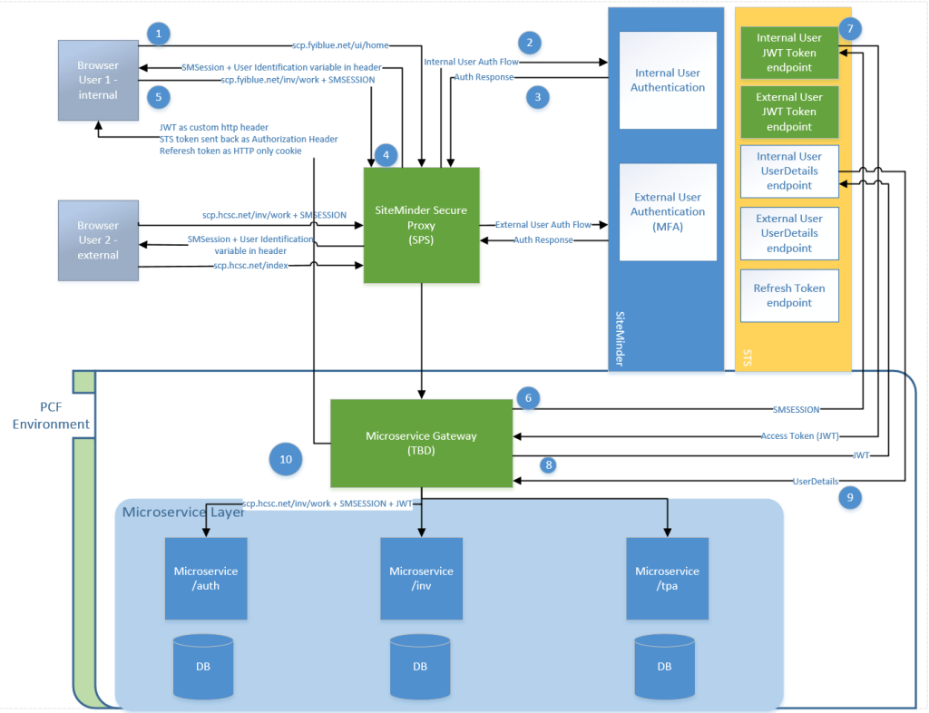
SCP Hub Architecture = Successful POC
What SCP started as a Proof of Concept is now supported by the Enterprise Architecture group and has become the HCSC standard for Single Sign-On architecture.
Note: Future State Architecture diagram excludes key elements that are specific to SCP (each Microservice having Security/Authorization/authentication, and the auth service does the authentication communication with STS)

Slide 7
Lessons Learned (Technical/Non-Technical)
Enterprise & Security Architecture
Dedicated resources from Enterprise Architecture & Security Architecture should be assigned to project.
The SCP team had multiple working sessions with multiple resources from Enterprise & Security Architecture teams resolving the following issues.
Process
Need to modernize development tooling stack to enable CI/CD across the board.
Enhance tooling platform to apply modern development techniques (TDD).
Collaboration
Co-located XP Team (ITPM (Customer), Developers, QA). No split allocations with other deliverables.
Pairing
Fully operational pairing stations with 1 PC and dual PC peripherals.
Enterprise Architecture | Security Architecture
Microservices and gateways | JWT (JSON Web Token)
PWA (Progressive Web App) and Single Page App | Client side authorization binding
No quick process for approving newer technologies | No solution to use security for local development

Slide 8
Ideal Future HCSC XP Projects
Products that
Can be scaled up rapidly to meet business demands.
Want to reduce risk in the pipeline to delivery.
Are fully planned for vs plan as you go.
Have multiple short development cycles to reduce the cost of changes in requirements.
Are able to dedicate a customer for the duration of the project.
Developers that are 110% committed to quickly build technical & domain knowledge.

